Slide 1
Office 365 Development

Slide 2
Office 365 Development Overview

Slide 3

Agenda
Intro
Office 365 App Model
Office 365 APIs
Tools
Resources

Slide 4
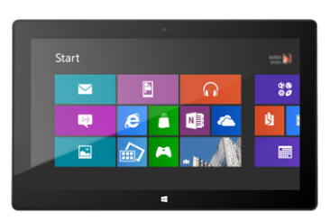
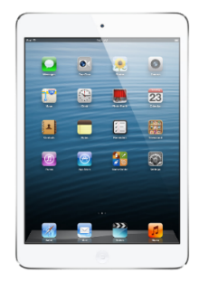


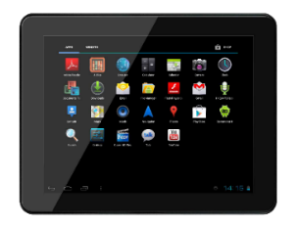
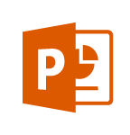
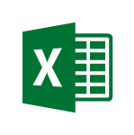
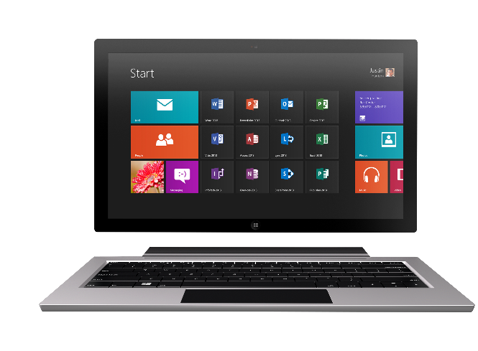
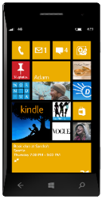
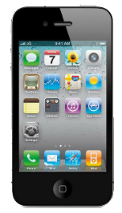
Technology journey
PC
1990s
PC + Servers
2000s
Devices + Cloud
2010s
VBA
VBA
Com add-ins
VSTO
FTC
Open standards
Mobile SDK’s
Notes:
Technology Journey
Respect for the investments that you’ve already made
Reaching out to a whole new world of possible.

Slide 5
The Opportunity
Mobile Devices
1.2B in 2014
1.8B in 2018
1B+
400+ PB
2-3 hours/day in Office Apps
Notes:
400+ Petabytes of data

Slide 6
Office 365 is a rich platform ripe for extending and integrating with.

Slide 7
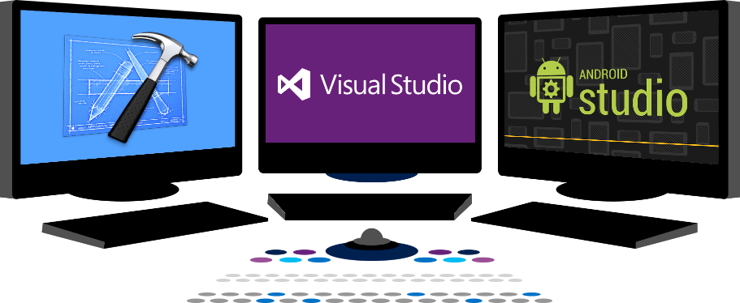














Vision
EXTEND OFFICE EVERYWHERE
CONNECT TO OFFICE 365 SERVICES
BUILD USING AN OPEN PLATFORM
Delve
z
Users and groups
Files
Mail
Calendar
My Apps
Video Portal
Contacts
Office Graph
Presentations
Documents
Spreadsheets
Lync
OneNote
Yammer

Slide 8
Office 365 App Model
Office 365 Development Overview

Slide 9


Contextual Apps
Your Apps, our UI
Surface your apps in the Office 365 platform
In Context
In context of your business users productivity activities
Reach
In Office Client, Office Online and Modern Apps
Notes:
The Cloud App Model provides a loosely coupled architecture for building apps in SharePoint 2013. This loosely coupled architecture gives the freedom of choice for developers in the technologies they use to not only host their applications but also the tools they use to write them. These apps leverage industry web standards such as HTML, JavaScript, jQuery, JSON, REST, OData and OAuth to provide apps an integrated user experience, yet architecturally provides for loose coupling with SharePoint 2013.
Apps for SharePoint execute “off-server” which allows for the app to scale independently of SharePoint and provides for a more secure SharePoint environment. You have complete control how apps interact with SharePoint. IT has complete control on how users discover, acquire and license apps. IT can specify which apps are white listed for install, or provide a mechanism where users can request an app that requires IT approval to install.
Apps can be accessible from any device with a web browser whether it be a PC, Tablet or smart phone. If it has a web browser that supports the latest web standards then it can be used.
Supporting Technologies
Client Side Rendering
Cloud App Model
REST End-Points
Client Object Model
OAuth 2.0
Visual Studio
NAPA

Slide 10

Web Standards
Apps are built using industry proven web standards such as HTML, JavaScript and REST
Scalable and Safe
Apps are independently scalable which reduces total cost of ownership. Apps are secured and isolated from SharePoint
Accessible
Apps can be accessed from any device with a web browser.
Build apps
Notes:
The Cloud App Model provides a loosely coupled architecture for building apps in SharePoint 2013. This loosely coupled architecture gives the freedom of choice for developers in the technologies they use to not only host their applications but also the tools they use to write them. These apps leverage industry web standards such as HTML, JavaScript, jQuery, JSON, REST, OData and OAuth to provide apps an integrated user experience, yet architecturally provides for loose coupling with SharePoint 2013.
Apps for SharePoint execute “off-server” which allows for the app to scale independently of SharePoint and provides for a more secure SharePoint environment. You have complete control how apps interact with SharePoint. IT has complete control on how users discover, acquire and license apps. IT can specify which apps are white listed for install, or provide a mechanism where users can request an app that requires IT approval to install.
Apps can be accessible from any device with a web browser whether it be a PC, Tablet or smart phone. If it has a web browser that supports the latest web standards then it can be used.
Supporting Technologies
Client Side Rendering
Cloud App Model
REST End-Points
Client Object Model
OAuth 2.0
Visual Studio
NAPA

Slide 11

Write once, run anywhere
An app can run outside the firewall in the cloud and from inside the firewall in a data center.
Hosting freedom
Apps can be hosted on any platform giving you complete freedom.
Re-use logic and assets
Build apps that can share logic and code with other web hosted solutions. Re-use existing services and assets within you app.
Build for the cloud
Notes:
By nature the Cloud App Model allows for the implementation of the app to be independent of the SharePoint platform. This gives you freedom of choose in how you develop and host your apps. This means you could develop them using Microsoft tools or non-Microsoft tools such as Eclipse. You can host the on Windows Azure or host them in Linux, Amazon Web Services, etc… The choices are endless and completely up to you.
The apps you right can re-use logic and code you already have for other web based apps or services. Or you can use logic and code for an app in other web apps or services. That’s the power and freedom of the cloud.
Supporting Technologies
Cloud App Model
Platform Agnostic

Slide 12









Modern app development
Apps
Products and platforms
Services and data
Expense
calculator
Vacation
request
Event
planning
Help-desk
support
Learning management
Risk
management
App catalog and store
Notes:
It’s worth spending some time taking you through how we think about modern app development at Microsoft. We have a series of products and platforms like SharePoint and Office that provide a lot of great out-of-the box functionality to help us be productive. To get even more from these products we want to be able to bring information in from other places. Services and data sources like Dynamics, Bing or something that lives out on the web or in the cloud.
With the latest version of SharePoint we’re making it easier to bring together rich web services and data to create powerful new apps. Apps run outside of the SharePoint process, are hosted externally and can be exposed through REST API’s.
Today there are more than 700,000 SharePoint application developers and with this release we’re providing them with a place to surface their apps through an online marketplace of rich partner solutions and applications designed to work with SharePoint and Office.

Slide 13

App Model Development
If you know general web development, you also know Office 365 development…
Notes:
Same code works in cloud and in on-premises
Build market place apps and reach all Office 365 customers easily
More flexible model with additional possibilities
Standard .NET development tooling

Slide 14


Distribution choices
Office Store
App Catalog
Notes:
Lifecycle
Not just the store
Momuntem has been building store and on-prem
Store features ; subscriptions
Business-ready
Corporate catalog
Training users to get new experiences

Slide 15


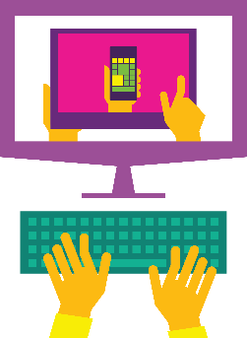

Store momentum
Exponential growth In-store visits
International expansion
Hundreds of business apps
Available in 142 markets
Notes:
Slow start, but building.
Not a device marketplace. No millions and millions of apps.
Tons of enhancement in the last year: subscriptions, regional, etc.
Lot of investment and expansion into new markets. Seeing good growth in new markets.
8 Additional Store Fronts Opening July
Local L:anguage Apps For :
China / Netherlands / Russia / Italy / Brazil
Recent Addition of subscription priced apps and paid Outlook apps
Store Refresh coming …

